Slide 1
Ibdiagnet
Unit 14

Slide 2
Outline
Ibdiagnet Overview
Fabric Debug basic process
Main ibdiagnet sections overview
Link speed verification
Ports counters
Scheduled fabric scan
Training
Objectives

Slide 3
ibdiagnet
An integrated IB fabric diagnostics command line tool
Scans the fabric using directed/lid routed packets
Extracts the available information regarding
Connectivity
Devices status
Checks for errors in the following scopes:
Ports – counters thresholds, port state
Nodes – firmware versions, LID assignments
Links – links speed and width
Fabric - topology matching, Subnet Manager, routing
Errors are reported to screen and saved in a log file

Slide 4
Tests and Features
Fabric discovery
Duplicated GUIDs detection
Duplicated node names
Links operational state
LIDs check:
No duplicated LIDs
No zero LIDs assigned
SM check:
There is one master Subnet Manager
The master Subnet Manager is the correct one
Port counters check:
No overflowed error counters are found
Modified threshold can be given for each counter
BER test:
Bit Error Rate calculation per time
Firmware check:
Verifies FW generations and validity for cluster components
Speed/Width checks:
Verifying that actual active speed and width matches its maximum supported capability

Slide 5

Fabric Debug
ibdiagnet -pc (command) first Clear all counters and then begin the test execution.
Wait for a certain time interval (between 30-60~ mins). Running MPI traffic on all nodes will also help
Check for errors that exceed the allowed threshold during this X time: ibdiagnet -ls 25 -lw 4x -P all=1
Fix problematic links (reseat or swap cables, replace switch ports or HCAs, etc.)
Go back to step 1 until fabric displays no further errors

Slide 6
ibdiagnet Main Output files
/usr/bin/ibdiagnet2
Use help or man ibdiagnet for detailed information
ibdiagnet runs and prints a short report
The detailed reports are under: /tmp (or as specified with -o flag)
Default Output Files:
Output File
Function
ibdiagnet.log
A dump of all the application reports generated
ibdiagnet.lst
A list of all the nodes, ports, and links in the fabric
ibdiagnet.fdbs
A dump of the unicast forwarding tables
ibdiagnet.mcfdbs
A dump of the multicast forwarding tables
ibdiagnet.sm
A list of all the SM (state and priority) in the fabric
ibdiagnet.pm
A dump of the PM counters values of the fabric links
ibdiagnet.pkey
A dump of the existing partitions and their member host ports
ibdiagnet.db_csv
A dump of the internal subnet database

Slide 7
Understanding the ibdiagnet Report Output 1
Report Summary and Messages Severity Level
I = Informative
W = Warning
E = Error
Summary
-I- Stage Warnings Errors Comment
-I- Discovery 0 0
-I- Lids Check 0 0
-I- Links Check 0 0
-I- Subnet Manager 0 0
-I- Port Counters 4 0
-I- Nodes Information 1 5
-I- Speed / Width checks 0 1
-I- Partition Keys 0 0
-I- Alias GUIDs 0 1
-I- You can find detailed errors/warnings in: /var/tmp/ibdiagnet2/ibdiagnet2.log
-I- ibdiagnet database file : /var/tmp/ibdiagnet2/ibdiagnet2.db_csv
-I- LST file : /var/tmp/ibdiagnet2/ibdiagnet2.lst
-I- Subnet Manager file : /var/tmp/ibdiagnet2/ibdiagnet2.sm
-I- Ports Counters file : /var/tmp/ibdiagnet2/ibdiagnet2.pm
-I- Nodes Information file : /var/tmp/ibdiagnet2/ibdiagnet2.nodes_info
-I- Partition keys file : /var/tmp/ibdiagnet2/ibdiagnet2.pkey
-I- Alias guids file : /var/tmp/ibdiagnet2/ibdiagnet2.aguid

Slide 8
Discovered Components
Discovery
-I- Discovering ... 13 nodes (5 Switches & 8 CA-s) discovered.
-E- FW Check finished with errors
-E- FW Check finished with errors
-W- mtlacad08/U2 - Node with Devid:4115(0x1013),PSID:MT_2190110032 has FW version 12.24.1000 while the latest FW version for the same Devid/PSID on this fabric is 12.26.1040
-W- mtlacad04/U2 - Node with Devid:4115(0x1013),PSID:MT_2190110032 has FW version 12.24.1000 while the latest FW version for the same Devid/PSID on this fabric is 12.26.1040

Slide 9
Nodes Information & Synchronized FW
Nodes Information
Nodes Information
-I- Retrieving ... 11/11 nodes (4/4 Switches & 7/7 CA-s) retrieved.
-W- Nodes Info retrieving finished with errors
-W- 6036B19GW/GW - The firmware of this device does not support general info capability
-E- FW Check finished with errors
-E- 6036A17/U1 - Node has wrong FW version 9.2.4340. Maximum available FW version for this device in the fabric is 9.2.7300
-E- S0002c903004b6883/N0002c903004b6880 - The firmware of this device returned invalid general info data
-E- ib-cert-sv02/U1 - The firmware of this device returned invalid general info data
-E- S0002c903004b6d53/U1 - The firmware of this device returned invalid general info data
-E- ib-cert-sv03/U1 - The firmware of this device returned invalid general info data
-E- FW Check finished with errors
-W- mtlacad08/U2 - Node with Devid:4115(0x1013),PSID:MT_2190110032 has FW version 12.24.1000 while the latest FW version for the same Devid/PSID on this fabric is 12.26.1040
-W- mtlacad04/U2 - Node with Devid:4115(0x1013),PSID:MT_2190110032 has FW version 12.24.1000 while the latest FW version for the same Devid/PSID on this fabric is 12.26.1040

Slide 10
components discovery
ibdiagnet is part of the features provided with OFED
Mellanox ibdiagnet may provide additional features beyond the OpenSM “standard“
ibdiagnet components discovery section
[root@ib-cert-sv01 ~]# /usr/bin/ibdiagnet
----------
Load Plugins from:
/usr/share/ibdiagnet2.1.1/plugins/
(You can specify more paths to be looked in with "IBDIAGNET_PLUGINS_PATH" env variable)
Plugin Name Result Comment
libibdiagnet_cable_diag_plugin Succeeded Plugin loaded
libibdiagnet_cable_diag_plugin-2.1.1 Failed Plugin options issue - Option "get_cable_info" from requester "Cable Diagnostic (Plugin)" already exists in requester "Cable Diagnostic (Plugin)"
Discovery
-I- Discovering ... 11 nodes (4 Switches & 7 CA-s) discovered.
-I- Fabric Discover finished successfully
-I- Discovering ... 11 nodes (4 Switches & 7 CA-s) discovered.
-I- Discovery finished successfully
-I- Duplicated GUIDs detection finished successfully
-I- Duplicated Node Description detection finished successfully
-I- Retrieving ... 11/11 nodes (4/4 Switches & 7/7 CA-s) retrieved.
-I- Switch Info retrieving finished successfully

Slide 11
Port counters
-I- Going to sleep for 1 seconds until next counters sample
-I- Ports counters retrieving (second time) finished successfully
-E- Ports counters value Check finished with errors
-E- lid=0x00e0 dev=51000 ibsw01-1/S01/U1/P31
Performance Monitor counter : Value
max_retransmission_rate : 65535 (overflow)
-E- lid=0x0121 dev=51000 ibsw01-1/L17/U1/P8
Performance Monitor counter : Value
max_retransmission_rate : 2964 (threshold=500)
-E- Ports counters Difference Check (during run) finished with errors

Slide 12
Speed / Width checks
Port Speed and Width
Shows ports that their active speed and bandwidth fails short to its supported capacity
Speed / Width checks
-I- Link Speed Check (Compare to supported link speed)
-E- Links Speed Check finished with errors
-E- Link: IBLF10/U1/P5<-->mtlacad07/U2/P1 - Unexpected actual link speed 14 (enable_speed1="2.5 or 5 or 10 or 14 or 25 or FDR10", enable_speed2="2.5 or 5 or 10 or 14 or 25 or 50" therefore final speed should be 25)
-I- Link Width Check (Compare to supported link width)
-I- Links Width Check finished successfully

Slide 13
Features and Command Line Options
The local IB port that is used to connect to the fabric is specified by one the following:
-lw <1x|4x|8x|12x> - specifies the link width
-ls <2.5|5|10|14|25|50> - specifies the link speed
Speed / Width checks
-I- Link Speed Check (Compare to supported link speed)
-E- Links Speed Check finished with errors
-E- Link: 6036B19GW/U1/P6<-->S0002c903004b6883/N0002c903004b6880/P1 - Unexpected actual link speed 2.5 (enable_speed1="2.5 or 5 or 10", enable_speed2="2.5 or 5 or 10" therefore final speed should be 10)
-I- Link Width Check (Compare to supported link width)
-I- Links Width Check finished successfully

Slide 14
Link speed
Speed / Width checks
-I- Link Speed Check (Compare to supported link speed)
-E- Links Speed Check finished with errors
-E- Link: IBSP08/U1/P6<-->mlnx-fdr-gw-2/U1/P6
Speed / Width checks
-I- Link Speed Check (Compare to supported link speed)
-E- Links Speed Check finished with errors
-E- Link: IBSP08/U1/P6<-->mlnx-fdr-gw-2/U1/P6 - Unexpected actual link speed FDR10 (enable_speed1="2.5 or 5 or 10 or 14 or 25 or FDR10", enable_speed2="2.5 or 5 or 10 or 14 or FDR10" therefore final speed should be 14)
-I- Speed / Width checks 0 1

Slide 15
Deeper search for within log file
Cat /var/tmp/ibdiagnet2/ibdiagnet2.log
-I- Link Speed Check (Compare to supported link speed)
-E- Links Speed Check finished with errors
-E- Link: IBLF10/U1/P5<-->mtlacad07/U2/P1 - Unexpected actual link speed 14 (enable_speed1="2.5 or 5 or 10 or 14 or 25 or FDR10", enable_speed2="2.5 or 5 or 10 or 14 or 25 or 50" therefore final speed should be 25)
[root@mtlacad01 ~]# ibswitches
Switch : 0x7cfe9003009a0550 ports 36 "MF0;IBLF10:MSB7700/U1" enhanced port 0 lid 11
ibportstate -C mlx5_1 -L 11 5 LinkState:.......................Active
PhysLinkState:...................LinkUp
LinkSpeedExtEnabled:.............14.0625 Gbps or 25.78125 Gbps or undefined (7)
LinkSpeedExtActive:..............14.0625 Gbps
ibwarn: [21824] validate_extended_speed: Peer ports operating at active extended speed 1 rather than 2 (25.78125 Gbps)

Slide 16
Using ibdiagnet Options for Advanced Cluster Analysis & optional flags
ibdiagnet -h
[root@ib-cert-sv01 ~]# ibdiagnet -h
NAME
ibdiagnet
SYNOPSYS
Main
[-i|--device <dev-name>] [-p|--port <port-num>]
[-g|--guid <GUID in hex>] [--vlr <file>]
[-r|--routing] [-u|--fat_tree] [-o|--output_path <directory>]
[--skip <stage>] [--skip_plugin <library name>]
[--pc] [-P|--counter <<PM>=<value>>]
[--pm_pause_time <seconds>] [--ber_test]
[--ber_use_data] [--ber_thresh <value>]
[--extended_speeds <dev-type>] [--pm_per_lane]
[--ls <2.5|5|10|14|25|FDR10>] [--lw <1x|4x|8x|12x>]
[-w|--write_topo_file <file name>]
[-t|--topo_file <file>] [--out_ibnl_dir <directory>]
[--screen_num_errs <num>] [--smp_window <num>]
[--gmp_window <num>] [--max_hops <max-hops>]
[-V|--version] [-h|--help] [-H|--deep_help]

Slide 17
Routing Components Collection
Routing
-I- EXT switch info retrieving finished successfully
-I- Adaptive Routing is enabled on 6 switches.
-I- AR data retrieving finished successfully
-I- Retrieving ... 23/23 nodes (6/6 Switches & 17/17 CA-s) retrieved.
-I- Unicast FDBS Info retrieving finished successfully

Slide 18
*BER Testing
--ber_test – perform BER test
--ber_use_data – use actual data to calculate BER for each port
--ber_thresh <value> – specify the BER threshold value
The reciprocal number of the BER should be provided. For example: For a BER of 10^-12, use --ber_thresh 1000000000000
If threshold given value marked as zero , all fabric ports BER values will appear in the log file
10^-12 would be the default value if no value is specified
The time between the two samples is set by the --pm_pause_time option
Port Counters
-I- Retrieving PMClassPortInfo ... 11/11 nodes (4/4 Switches & 7/7 CA-s) retrieved.
-I- Retrieving ... 11/11 nodes (4/4 Switches & 7/7 CA-s) retrieved.
-W- Ports counters retrieving finished with errors
-W- 4036E-v-sup-sw01/IPR - This device does not support xmit wait counter capability
-W- 4036E-v-sup-sw01/IPR - This device does not support extended port counters capability
-W- 6036B19GW/GW - This device does not support xmit wait counter capability
-W- 6036B19GW/GW - This device does not support extended port counters capability
-I- Going to sleep for 1 seconds until next counters sample
-I- Time left to sleep ... 1 seconds.
-I- Retrieving ... 11/11 nodes (4/4 Switches & 7/7 CA-s) retrieved.
-I- Ports counters retrieving (second time) finished successfully
-I- Ports counters value Check finished successfully
-I- Ports counters Difference Check (during run) finished successfully
-I- BER Check finished successfully
ibdiagnet --ber_test --ber_thresh 100000000000000 (10^-12)
* Supported in QDR and FDR generations

Slide 19
Effective BER Check
-I- Effective BER Check finished successfully
-E- Effective BER Check 2 finished with errors
-W- S1c34da030047c144/N1c34da030047c144/P10/1 - BER exceeds threshold - BER value = 2.000000e-13 / threshold = 1.000000e-13
-W- S1c34da030047c244/N1c34da030047c244/P8/2 - BER exceeds threshold - BER value = 5.000000e-13 / threshold = 1.000000e-13

Slide 20
Create a Topology File
ibdiagnet -w
MSB7700 IBLF09
P1 -4x-25G-> HCA_2 mtlacad01 U2/P1
P11 -4x-25G-> MSB7700 IBSP07 P11
P12 -4x-25G-> MSB7700 IBSP08 P12
P2 -4x-25G-> HCA_2 mtlacad02 U2/P1
P5 -4x-25G-> HCA_2 mtlacad03 U2/P1
P6 -4x-25G-> HCA_2 mtlacad04 U2/P1
P7 -4x-25G-> HCA_2 mtlacad09 U2/P1
P8 -4x-25G-> HCA_2 mtlacad10 U2/P1
MSB7700 IBLF10
P1 -4x-25G-> HCA_2 mtlacad05 U2/P1
P11 -4x-25G-> MSB7700 IBSP08 P11
P12 -4x-25G-> MSB7700 IBSP07 P12
P2 -4x-25G-> HCA_2 mtlacad06 U2/P1
P5 -4x-25G-> HCA_2 mtlacad07 U2/P1
P6 -4x-25G-> HCA_2 mtlacad08 U2/P1
P7 -4x-25G-> HCA_2 mtlacad11 U2/P1
P8 -4x-25G-> HCA_2 mtlacad12 U2/P1
[root@ib-cert-sv01 ~]# ibdiagnet -w oded.top
----------
Load Plugins from:
/usr/share/ibdiagnet2.1.1/plugins/
(You can specify more paths to be looked in with "IBDIAGNET_PLUGINS_PATH" env variable)
-I- ibdiagnet database file : /var/tmp/ibdiagnet2/ibdiagnet2.db_csv
-I- LST file : /var/tmp/ibdiagnet2/ibdiagnet2.lst
-I- Topology file : oded.top
-I- Subnet Manager file : /var/tmp/ibdiagnet2/ibdiagnet2.sm
-I- Ports Counters file : /var/tmp/ibdiagnet2/ibdiagnet2.pm
-I- Nodes Information file : /var/tmp/ibdiagnet2/ibdiagnet2.nodes_info
-I- Partition keys file : /var/tmp/ibdiagnet2/ibdiagnet2.pkey
-I- Alias guids file : /var/tmp/ibdiagnet2/ibdiagnet2.aguid

Slide 21
Analyzing fabric Congestion Using PM Counters
Create a congestion map using PM (Performance Monitor) counters.
Use ibsiganet2 ibdiagnet2.db_csv output file:
Step 1: Copy the “PM_INFO” data from the file to an Excel sheet
Step 2: Calculate the congestion index = XmitWait / XmitPkt
Step 3: Complete data and analyze results
Congestion index Definition: Normalized XmitWait = ∆XmitWait / ∆XmitPackets Ports with congestion index >= 10 , should be treated as congested
See relevant example in the next slide
[root@mtlacad01 ~]# perfquery
LocalLinkIntegrityErrors:........0
ExcessiveBufferOverrunErrors:....0
QP1Dropped:......................0
VL15Dropped:.....................0
PortXmitData:....................7064064
PortRcvData:.....................6380064
PortXmitPkts:....................98112866
PortRcvPkts:.....................88612
PortXmitWait:....................25888
Notes:
Using 32/64-bit counters. 64-bit counters require additional translation from Hex to Dec
Not absolute congestion indication – but good input

Slide 22
PM Counters and Congestion Index Calculation Example
Port 1 Example:
port_xmit_wait=0x07888c91 -> 126,389,393
port_xmit_pkts=0x0485e2ae -> 75,883,182
port_xmit_wait/port_xmit_pkts=126,389,393/75,833,182=1.66
Congestion_index=1.66
Port 2 Example:
port_xmit_wait=0xffffffff -> 4,294,967,295
port_xmit_pkts=0x043e779e -> 71,202,718
port_xmit_wait/port_xmit_pkts= 4,294,967,295/ 71,202,718=60.32
Congestion_index=60.32
Ports with congestion index >= 10 , should be treated as congested
http://www.binaryhexconverter.com/hex-to-decimal-converter
[root@mtlacad01 ~]# perfquery
# Port counters: Lid 20 port 1 (CapMask: 0x5A00)
PortSelect:......................1
CounterSelect:...................0x0000
SymbolErrorCounter:..............0
LocalLinkIntegrityErrors:........0
ExcessiveBufferOverrunErrors:....0
QP1Dropped:......................0
VL15Dropped:.....................0
PortXmitData:....................7064064
PortRcvData:.....................6380064
PortXmitPkts:....................98112866
PortRcvPkts:.....................88612
PortXmitWait:....................25888

Slide 23
Having extra unknown cable edge ?
ibdiagnet --get_cable_info
-------------------------------------------------------
Port=1 Lid=0x0003 GUID=0x1c34da030060cd61 Port Name=mtlacad10/U2/P1
-------------------------------------------------------
Vendor: Mellanox
OUI: 0x2c9
PN: MCP1600-E002
SN: MT1504VS00108
Rev: A2
Length: 2 m
Type: Copper cable- unequalized
SupportedSpeed: SDR/DDR/QDR/FDR/EDR
Temperature: N/A

Slide 24
Net_dump provides Fabric regenerated data Following Detected Errors
[root@mtlacad01 ~]# cat /var/tmp/ibdiagnet2/ibdiagnet2.net_dump> /tmp/net_dump
"MF0;IBLEAF03:MQM8700/U1", Mellanox, 0x1c34da030053828c, LID 12
# : IB# : Sta : PhysSta : MTU : LWA : LSA : FEC mode : Retran : Neighbor Guid : N# : NLID : Neighbor Desc
1 : 1 : ACT : LINK UP : 5 : 4x : 50 : MLNX_RS_544_514_PLR : NO-RTR : 0x1c34da030060cde8 : 1 : 1 : "mtlacad03 HCA-1“
3 : 3 : DOWN : POLL : N/A : N/A : N/A : N/A : N/A : : : :
4 : 4 : ACT : LINK UP : 5 : 4x : 50 : MLNX_RS_544_514_PLR : NO-RTR : 0x1c34da030060cdc8 : 1 : 22 : "mtlacad04 HCA-1“
"MF0;IBLF09:MSB7700/U1", Mellanox, 0x7cfe9003009a0490, LID 15
# : IB# : Sta : PhysSta : MTU : LWA : LSA : FEC mode : Retran : Neighbor Guid : N# : NLID : Neighbor Description
1 : 1 : ACT : LINK UP : 5 : 4x : 25 : STD-LL-RS : NO-RTR : 0x1c34da030060cf01 : 1 : 9 : "mtlacad01 HCA-2“
2 : 2 : ACT : LINK UP : 5 : 4x : 25 : STD-LL-RS : NO-RTR : 0x1c34da030060cd29 : 1 : 23 : "mtlacad02 HCA-2“
11 : 11 : ACT : LINK UP : 5 : 4x : 25 : NO-FEC : NO-RTR : 0x7cfe9003009a0450 : 11 : 10 : "MF0;IBSP07:MSB7700/U1"

Slide 25
Perfquery & congestion index calculation
[root@mtlacad01 ~]# perfquery
# Port counters: Lid 20 port 1 (CapMask: 0x5A00)
PortSelect:......................1
CounterSelect:...................0x0000
SymbolErrorCounter:..............0
LocalLinkIntegrityErrors:........0
ExcessiveBufferOverrunErrors:....0
QP1Dropped:......................0
VL15Dropped:.....................0
PortXmitData:....................7064064
PortRcvData:.....................6380064
PortXmitPkts:....................98112866
PortRcvPkts:.....................88612
PortXmitWait:....................25888

Slide 26
Scheduled Fabric Scan Task

Slide 27
Ibdiagnet and crontab Tools
In the following slides, you will learn how to perform a routine background job of the ibdiagnet utility using the crontab tool
ibdiagnet
Scans the fabric
Extracts all the available information regarding connectivity and devices
It then produces log files in the output directory
crontab
Time-based job scheduler in Unix-like computer operating systems
Used to schedule jobs (commands or shell scripts) to run periodically at fixed times, dates, or intervals
Important notice: running fabric scan on the background on production environment may load and affect production traffic/congestion

Slide 28
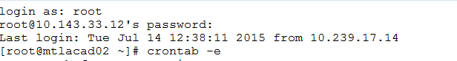
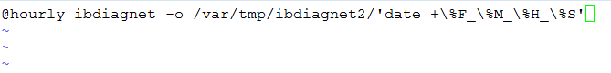
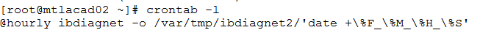
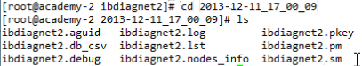
Fabric Scan Scheduled Task
Type the command crontab –e to enter the crontab editor mode.
Type the command @hourly ibdiagnet –o /var/tmp/ibdiagnet2/`date +\%F_\%M_\%H_\%S`
Notice that you must leave a blank line below the command in the crontab editor mode. The scheduled job will not run unless you do so.
Type the command crontab –i to view and validate the crontab’s content.
The ibdiagnet will now run every single hour.
[root@mtlacad02 ~]# cd /var/tmp/ibdiagnet2/
[root@mtlacad02 ibdiagnet2]# ls
2015-7-15_15_00_09 ibdiagnet2.aguid ibdiagnet2.db_csv ibdiagnet2.fdbs ibdiagnet2.lst ibdiagnet2.net_dump ibdiagnet2.pkey ibdiagnet2.sm
Enter the ibdiagnet folder and view its content.
You can see that a new folder with the correct date and hour format has been created.
[root@mtlacad02 ibdiagnet2]# cd 2015-7-15_15_00_09
Enter the date folder and view its content.
You can see that the new folder contains ibdiagnet logs.
You may now open them to view their content.
[root@mtlacad02 2015-7-15_15_00_09 ]# ls
Notes:
@Hourly – Commands the crontab to run the command every hour
Ibdiagnet -o – Specifies the directory where the output files will be placed
’date +\%F_\%M_\%H_%S’ – Prints the date in which the ibdiagnet was executed into a new folder

Slide 29
crontab Fields and Allowed Ranges
crontab Fields and Allowed Ranges:
Field
Description
Allowed Value
MIN
Minute field
0 to 59
HOUR
Hour field
0 to 23
DOM
Day of the month
1 to 31
MON
Month field
1 to 12
DOW
Day of the week
0 to 6
CMD
Command
Any command to be executed
Instead of @hourly command, you can place date information in the following method:
0****, where * means all.
* in the hour field represent “all hours”.

Slide 30
Monitoring with OpenSM Logs

Slide 31

OpenSM Message Look Up
Useful Log Messages
Message Type
Description
ERR
Error messages
tables
Routing engine
Log_trap_info
Switch/Host trap messages
-I removed
Removed ports
-I Timeout
MAD timeout
grep <Message Type> /var/log/opensm.log

Slide 32
OpenSM Message Example
Verify that OpenSM has successfully activated the subnet:
If OpenSM was able to setup the subnet correctly, its log file should include the message "SUBNET UP".
Use locate opensm.log to find it location ( or find command )
Verify routing engine convergence:
[root@mtlacad02 ~]# cat /var/log/opensm.log | grep 'SUBNET UP'
Jul 20 14:10:27 564635 [C1598700] 0x02 -> SUBNET UP
[root@mtlacad02 ~]# grep table /var/log/opensm.log
Jul 20 14:10:27 556075 [C1598700] 0x02 -> osm_ucast_mgr_process: minhop tables configured on all switches
[root@mtlacad02 ~]# cat /var/log/opensm.log | grep updn
Jul 20 14:10:27 555993 [C1598700] 0x02 -> updn_lid_matrices: disabling UPDN algorithm, no root nodes were found
[root@mtlacad02 ~]# cat /var/log/opensm.log | grep table
Jul 20 14:38:07 714802 [ECD47700] 0x02 -> osm_ucast_mgr_process: updn tables configured on all switches

Slide 33
How to View Previous Log Files?
[root@mtlacad02 ~]# ls /var/log/
audit dracut.log-20160508 messages-20160731 opensm-statistics.dump spooler wtmp
boot.log httpd ntpstats opensm-subnet.lst spooler-20160710 yum.log
btmp lastlog opensm.log opensm-unhealthy-ports.dump spooler-20160717
btmp-20160701 messages opensm.log-20160711.gz prelink spooler-20160724
ConsoleKit messages-20160710 opensm.log-20160718.gz sa spooler-20160731
dmesg messages-20160717 opensm.log-20160724.gz samba srp_daemon.log
dmesg.old messages-20160724 opensm.log-20160731.gz sa-update.log tallylog
[root@mtlacad02 ~]# gunzip /var/log/opensm.log-20160711.gz
[root@mtlacad02 ~]# cat /var/log/opensm.log-20160711
Jul 10 11:52:02 063706 [2A7A7700] 0x03 -> OpenSM 4.6.1.MLNX20160112.774e977
OpenSM 4.6.1.MLNX20160112.774e977
Jul 10 11:52:02 063752 [2A7A7700] 0x80 -> OpenSM 4.6.1.MLNX20160112.774e977
Using default GUID 0xf45214030033d1d1
Entering DISCOVERING state

Slide 34
OpenSM Logs Configuration Example
The SM log file size can be changed from 3MB to 5MB.
You can choose how often a new SM log file will be created: daily, weekly (default), monthly.
The SM log file will reach its maximum log size, or it will obey the rotational periodically order.
Modify the OpenSM log maximum file size:
vi /etc/opensm/opensm.conf Look for /log_max_size and change the size
Modify the OpenSM log frequency rotation:
vi /etc/logrotate.d/opensm Look for daily, weekly, monthly and change accordingly

Slide 35
Open SM Logs Errors and Traps

Slide 36
OpenSM Logs
OpenSM logs are under (by default):
/var/log/opensm.log and all errors reported in this second file should be treated as indicators of IB fabric health issues
OpenSM logs are also available when using UFM
[root@mtlacad03 ~]# more /opt/ufm/files/log/opensm.log
Oct 26 08:37:52 441537 [307B9700] 0x02 -> event_send_thread: ufm_plugin_destroying
Oct 26 08:37:52 444467 [4F3A9740] 0x80 -> Exiting SM
Oct 26 08:38:06 659479 [FAAF740] 0x03 -> OpenSM 5.7.1_ee4c02e
Oct 26 08:38:06 659523 [FAAF740] 0x80 -> OpenSM 5.7.1_ee4c02e
Oct 26 08:38:06 661074 [FAAF740] 0x02 -> osm_vendor_init: 1000 pending umads specified
Oct 26 08:38:06 661146 [FAAF740] 0x02 -> osm_vendor_init: 1000 pending umads specified
Oct 26 08:38:06 663827 [FAAF740] 0x80 -> Entering DISCOVERING state Jan 23 12:33:40 959787 [9953A740] 0x02 -> osm_vendor_bind: Mgmt class 0x81 binding to port GUID 0x7cfe9003005d7b2e
Jan 23 12:33:40 991357 [9953A740] 0x02 -> osm_vendor_bind: Mgmt class 0x03 binding to port GUID 0x7cfe9003005d7b2e Oct 26 08:38:07 323549 [78EC700] 0x02 -> log_notice: Reporting Generic Notice type:4 num:144 (CapabilityMask, NodeDe
scription, Link [Width|Speed] Enabled, SM priority changed) from LID:1 GID:fe80::1c34:da03:60:cde8
Oct 26 08:38:07 333082 [F1EC1700] 0x02 -> osm_ucast_cache_process: Configuring switch tables using cached routing
Oct 26 08:38:07 334099 [F1EC1700] 0x01 -> osm_enhanced_qos_mgr_parse_config: ERR 0707: Enhanced QoS Policy File Pars
ing Failed

Slide 37

SM Information and Active Routing Engine Verification
Find the SM:
Query node description:
Make sure the routing algorithm converged as expected:
sminfo
sm lid 573 sm guid 0x2c90300fe2ed1, activity count 26181972 priority 15 state 3 SMINFO_MASTER
smpquery nd 573
Node Description:.......................sm2 HCA-1
grep table opensm.log Feb 19 10:42:25 488716 [321B1700] 0x02 -> osm_ucast_mgr_process: updn tables configured on all switches
Tool Usage
Notes:
SMINFO is sent directly to the subnet manager
Its response returns of course as SMP

Slide 38
SA Query
You can query nodes using the saquery tool.
[root@mtlacad02 ~]# saquery 8
NodeRecord dump:
lid.....................8
reserved................0x0
base_version............0x1
class_version...........0x1
node_type...............Channel Adapter
num_ports...............2
sys_guid................0xf45214030033d083
node_guid...............0xf45214030033d080
port_guid...............0xf45214030033d081
partition_cap...........0x80
device_id...............0x1003
revision................0x1
port_num................1
vendor_id...............0x2C9
NodeDescription.........mtlacad01 HCA-1
Tool Usage

Slide 39
ERR 3113 – MAD Completed in Error
Feb 17 10:56:41 275109 [309AE700] 0x01 -> Received SMP on a 4 hop path: Initial path = 0,1,20,17,9, Return path = 0,0,0,0,0
Feb 17 10:56:41 275116 [309AE700] 0x01 -> sm_mad_ctrl_send_err_cb: ERR 3113: MAD completed in error (IB_TIMEOUT): SubnGet(PortInfo), attr_mod 0x0, TID 0x11ebace2
Feb 17 10:56:41 275133 [309AE700] 0x01 -> log_send_error: ERR 5411: DR SMP Send completed with error (IB_TIMEOUT) – dropping
A MAD sent to the destination was not completed
Use smpquery to demand link state and node description:
smpquery pi - D 0,1,20,17,9
smpquery nd -D 0,1,20,17,9
Notes:
MAD - Completed in Error can be caused by a lot of reasons , as you can see after subnet GET– Port Info information that was requested and not answered (examples ) :
Sl to vl
Pkey
ERROR 3113 refers to a non succesful Get port info
Pay Attention the additionall ERROR 5411 –TIME OUT means that the requested information totally did not arrive .

Slide 40
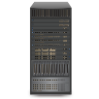
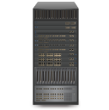
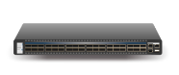
ERR 3315 - Unknown Remote Side for Node
Feb 17 10:56:40 433133 [321B1700] 0x01 -> state_mgr_light_sweep_start: ERR 3315: Unknown remote side for node 0x0002c90300619ab0 (MF0;io01-ib1:SXX536/L18/U1) port 8. Adding to light sweep sampling list
Feb 17 10:56:40 433140 [321B1700] 0x01 -> Directed Path Dump of 3 hop path: Path = 0,1,19,18
Direct Path Convention:
0, 1, 19, 8
The originator Host Always 0
The Host port Number used in this session
The Egress Port Exit from the first/next Hop
The Egress Port Exit to the Destination Host
?
0
Port 1
Port 19
Port 8

Slide 41
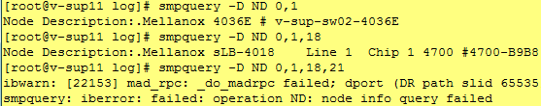
Identifying the Impacted “Lost“ Remote Port
Trace the last component responses the MADS:
We have detected the last working component in that route, we can identify the component GUID, as we already know its node description
For that purpose you can sort ibhosts or ibswitches or ibnetdiscover results
Now you will use iblinkinfo –S <switch GUID>: in order to check the status of the port disconnecting the “chain“ in the heart of this log

Slide 42

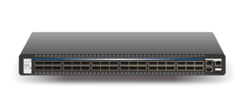
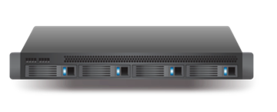
Management Traps
Message sent by a management agent to its class manager when certain asynchronous management events occur (such as protocol violations)
The trap message has its data in the form of a notice attribute
The SM programs the node with information about where to send the trap
The node stops sending the trap when it receives a TrapRepress
IB devices use SMPs to send traps to the SM when certain events occur
Event for example: a switch detects a state change on one of its ports (i.e., a topology change and/or device joining or leaving)
Trap
Trap
Trap
TrapRepress

Slide 43
Traps 64-67 - Informational Traps from the SM
In and Out of Service Traps
Trap 64: <GIDADDR> is now in service
Trap 65: <GIDADDR> is out of service
The events reported by these Notices (traps 64-65) indicate that an endport's reachability from a subscribing endport has changed
Endport A is reachable from subscriber endport B if there is a PathRecord with source B and destination A
Endport reachability may change as a result of:
changes to restrictions on access through partitioning
endports commencing or ceasing participation on the subnet
Multicast Group Create/Delete Traps
Trap 66: New multicast group with multicast address <GIDADDR> is now created
Trap 67: Multicast group with multicast address <GIDADDR> is now deleted
Trap numbers 66 and 67, indicating when a multicast group is created or deleted, are events that are generated by the SA when a multicast group is created or deleted

Slide 44
Trap 128
Num 128: Link state change
Always generated by a switch due to a port status change
Used mainly as a trigger for the SM to start a sweep
Finding the link that failed:
* Remember, link down isn’t necessarily an error, it will also appear when a server is rebooted
log_trap_info: Received Generic Notice type:1 num:128 (Link state change) Producer:2 (Switch) from LID:58 TID:0x000000000000010e
for i in {1..36};do echo Port:$i;perfquery 58 $i | grep LinkDownedCounter;done

Slide 45
Trap 129
Feb 21 08:53:04 342099 [369BA700] 0x01 -> log_trap_info: Received Generic Notice type:1 num:129 (Local Link integrity threshold reached) Producer:2 (Switch) from LID:376 Port 3 TID:0x0000000000000095
Use perfquery to query error counters:
perfquery 376 3
# Port counters: Lid 376 port 3 (CapMask: 0x1300)
PortSelect:......................3
CounterSelect:...................0x0000
SymbolErrorCounter:..............0
LinkErrorRecoveryCounter:........174
LinkDownedCounter:...............1
PortRcvErrors:...................7311
PortRcvConstraintErrors:.........0
CounterSelect2:..................0x00
LocalLinkIntegrityErrors:........12
ExcessiveBufferOverrunErrors:....0
Notes:
Port level traps 129-130-131
Usually do not cause sweep to occur
There might be a situation that situation of Flow Control 131 will indirectly cause 128 , that is after the FW will decide to reset the port
All of those traps are a result of problems on the Link
The problems might be different, and have to be checked both with switch and CA people (FW experts both sides )

Slide 46
Routing Troubleshooting

Slide 47
Credit Loop Found ( log file )
###################################
-I- Credit Loops Report:
###################################
-I- Analyzing Fabric for Credit Loops 1 SLs, 8 VLs used.
-I- Traced 170 unicast paths
-E- Credit loop found on the following path:
from port:mtlacad07/U1/P1 VL: 0 to port:Sb8599f030014b8b0/Nb8599f030014b8b0/P12 VL: 0 on path from lid: 0x000 8 to lid: 0x0015
from port:Sb8599f030014b8b0/Nb8599f030014b8b0/P12 VL: 0 to port:IBSP01/U1/P9 VL: 0 on path from lid: 0x0008 t o lid: 0x0017
from port:IBSP01/U1/P9 VL: 0 to port:Sb8599f030009118e/Nb8599f030009118e/P12 VL: 0 on path from lid: 0x000d t o lid: 0x000c
from port:Sb8599f030009118e/Nb8599f030009118e/P12 VL: 0 to port:IBSP02/U1/P11 VL: 0 on path from lid: 0x0016 to lid: 0x0008
from port:IBSP02/U1/P11 VL: 0 to port:Sb8599f030014b8b0/Nb8599f030014b8b0/P12 VL: 0 on path from lid: 0x000a to lid: 0x000e
-E- credit loops in routing

Slide 48
Ibdiagnet Report –Problem is solved
Mar 24 12:23:00 770430 [99C0E700] 0x02 -> osm_ucast_mgr_process: updn tables configured on all switches
###################################
-I- Credit Loops Report:
###################################
-I- Analyzing Fabric for Credit Loops 1 SLs, 15 VLs used.
-I- Traced 104 unicast paths
-I- no credit loops found

Slide 49
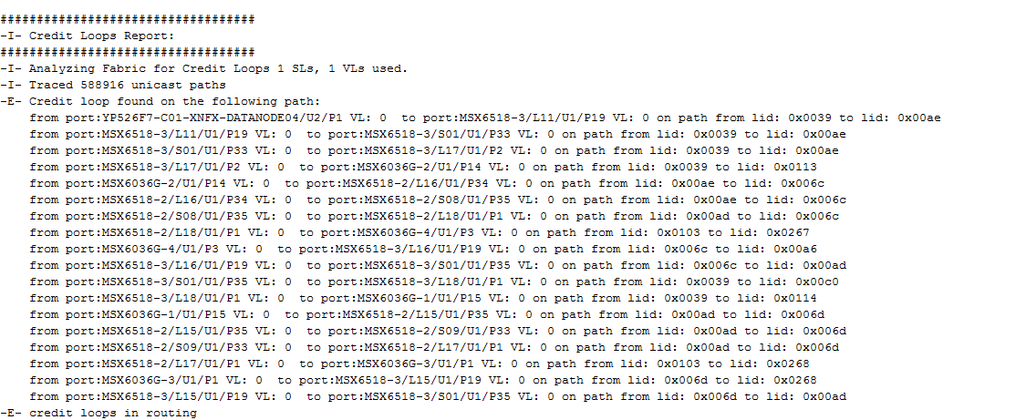
Locate Credit Loops
Locate credit loops:
ibdiagnet -r
In the log file locate the credit loops section

Slide 50
Unassigned LFTs
No routing is found between one node to another
Possible reasons:
One of the links is down and the routing is changed
Wrong configuration of the root switches in the fabric
Wrong cabling that contradicts the UPDN rules
Mismatch between routing and topology
# ibdiagnet -r ..... -I- -I- Verifying all CA to CA paths ... -E- Unassigned LFT for lid:1 Dead end at:S0800690000004057/U1 -E- Fail to find a path from:switch1/U1/1 to:switch2/U1/1

Slide 51
Routing Convergence
Validate the routing algorithm converged as correctly
Failure example:
grep table opensm.log
Feb 19 10:42:25 488716 [321B1700] 0x02 -> osm_ucast_mgr_process: updn tables configured on all switches
Jul 08 15:17:53 866381 [5D6F4700] 0x02 -> Fabric has 1 switches - topology is not fat-tree. Falling back to default routing
Jul 08 15:17:53 866391 [5D6F4700] 0x01 -> ucast_mgr_route: ftree: cannot build lid matrices.
Jul 08 15:17:53 866440 [5D6F4700] 0x02 -> osm_ucast_mgr_process: minhop tables configured on all switches

Slide 52

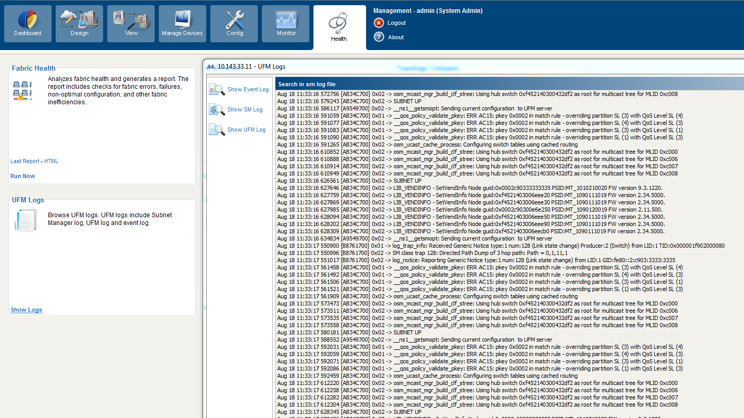
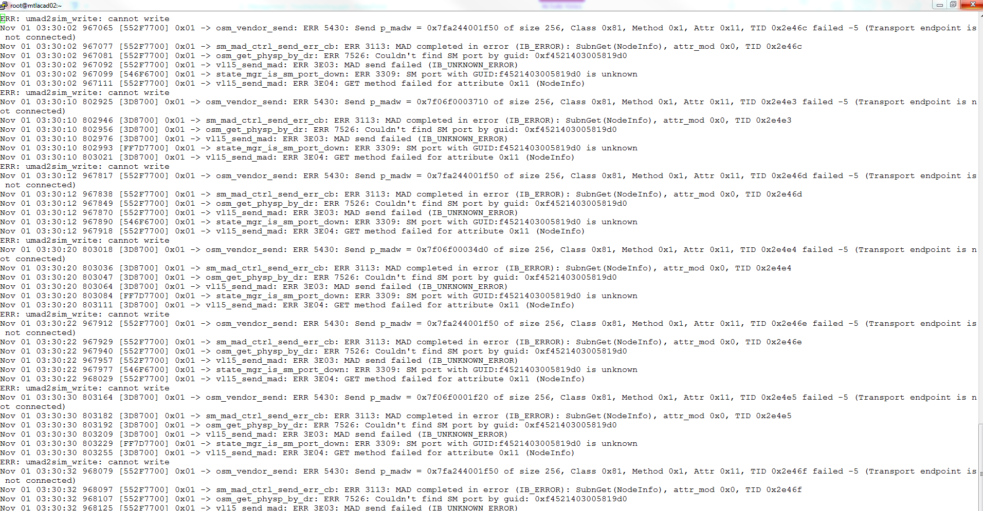
Unit Summary
Trap
Trap
Trap
TrapRepress

Slide 53
Outline
Ib diagnet
Schedueled FabricScan
Monitoring with OpenSM Logs
Routing Troubleshooting
Training
Objectives

Slide 54
INFINIBAND CLUSTER all in one testing tool ????
ibdiagnet
ibdiagnet –pc
Show ibdiagnet sections
Show fabric nodes section
Show fw errors slides 9
Show speed link function and the fabric example
Show how to run cable info
Show the cables result info
Show the grep cable result of the element with the degraded result
Show lid inspection fabric
Show node desc duplication ibdiagnet HDR , fix for switches with Mellanox tool manage the Un managed
Show errored ports slide 13
Check routing credit loops show command ibdiagnet –r , show slide 19 & than slide 20
Optional problem wrong deployment or routing engine parameters definitions
Show opensm.conf routing engines section
Final after correction of the problematic issues run the ibdiagnet again till fixes are achieved
Prepare your cluster towards its testing
Verify that your cluster nodes are live and kicking
Diagnostic tool main functionalities
Check that your fabric nodes have the same fw version
Check/make that all your fabric links function in its optimal speed and bandwidth.
Check that your fabric LID addresses distributed properly without duplication
Check that fabric nodes have no name duplication , in order to allow simpler identification and operation
Analyze fabric errored ports find the reason for its faults and clear them
Make sure your fabric has no credit loops
When all modifications and required fixes are done re run the process to verify a clean test
Now your fabric is perfect – Define an automatic process that will run the diagnostic as a routine process , its results will be monitored daily making sure no new faults are accumulated .

Slide 55

HCA SW Installation – Multiple Nodes
It is necessary to have some sort of parallel remote shell utility
For this specific demonstration, you will use the PDSH tool, which can be found here:
https://code.google.com/p/pdsh/
Make sure such a tool is installed on at least one server in the IB fabric
[root@mtlacad02 ~]# pdsh -R ssh -w mtlacad[01-12] ofed_info -s |dshbak –c
pdsh -R ssh -w mtlacad[01-12] ibstat -d mlx5_0
[root@mtlacad02 ~]# pdsh -R ssh -w ^/train/hostfile uname -a | dshbak -c
PDSH
Notes:
[root@mtlacad02 ~]# pdsh -R ssh -w mtlacad0[1-4] ofed_info -s |dshbak -c
mtlacad02: Permission denied, please try again.
mtlacad02: Permission denied, please try again.
mtlacad02: Permission denied (publickey,gssapi-keyex,gssapi-with-mic,password).
pdsh@mtlacad02: mtlacad02: ssh exited with exit code 255
----------------
mtlacad01
----------------
MLNX_OFED_LINUX-3.1-1.1.2.0:
----------------
mtlacad[03-04]
----------------
MLNX_OFED_LINUX-3.2-2.0.0.0:

Slide 56
PRACTICE MAIN TASKS
Run ibdiagnet
How many nodes discovered in the fabric
How many switches discovered in the network
How many Cas discovered in the network
IF there are components in the fabric that might need to update FW , detail 2 of the components , what is their current FW, and what is the FW version they might be updated to .
Are there any links found with degraded (speed or width) , If there are detail 2 of them , and provide their exact details of the link both ends .
Do you have errored counters in the fabric detail 2 of the errored ports , the affected counter and its current value
Did you find other counters problem , detail what are the errors described
Identify what are the Master SM & Stand BY in the fabric , detail its LID & Node description
Which flag should be used in order to check credit loops
Which flag should you use in order to create “ visual “ topology file create that file under /tmp/

Slide 57
Main stages tests
Ibdiagnet
Degraded links
Check errors xmit wait & congestion levels
Routing loops
Name duplication
Fw update
Opensm.log
Routing improvement – scatter , updn , AR for edr+ & connect x5 minimum
Routing & performance improvement because of degraded links not faulty
Switches health check
Adapter cards fw
Performance test for ipoib
Performance test for rdma regular
Install fabric inspector on one spine
Install manage the un managed for naming & data of the unmanaged switches

Slide 58
Need to do
10 basic tools each hpc ib should do
Demo demo demo – might be recorded
Thinks the customer cannot do – performance , neo dump
Sm logs special events

Slide 59
Stas & vitaly
Ibdiagnet monitor new tool ? Mellanox only
Fw – there is a fw deployed on other switches or Cas , that is newer than the one exist on specific element – must be done only during maintenance window , or at list taking this element out of the fabric - so it wont affect other servers traffic
When elements show problems , we should go to iblinkinfo , ibnetdiscover , tracert and show exactly the routes it take to other servers
Routing –r
Credit loop discovered may be bad deployment cabling wrong root guid definitions
Fec is activated , but effective ber provides ber 10 -15
Repetative servers with problems errors counters + should be suspected , cables etc ,,,
Undetected cables also servers name appear , might be vm servers
New added card with chain cables to use same PCI
Mixed environment elements cause link speed degraded , fw or cards that s.t might not support for example specific counters
Subnet manager information – to verify that no “ wrong “ sm that should not be part of the fabric
Ibdiagnet -w , might be compared with .lst file content ---- new topology tool created this year auto script saves the very long excel jobs
Duplicated names of switches ----- may be corrected - with ufm-sdk tool , or manage the un managed
Opensm.log cat /……/opensm.log | grep tables

Slide 60
Wrong deployment fixed ( hosts on spines )
###################################
-I- Credit Loops Report:
###################################
-I- Analyzing Fabric for Credit Loops 1 SLs, 15 VLs used.
-I- Traced 32 unicast paths
-I- no credit loops found
Still using min hop

Slide 61
“ valid “ SM check

Slide 62
Set node description script
From: Vitaly Segal Sent: Wednesday, February 5, 2020 12:48 PM To: DamianoP@DoIT <damiano.pagliaro@doit-systems.it>; Manilo Trocano <manilo.trocano@doit-systems.it> Subject: Script to get the correct c5node name in ibhosts
/usr/sbin/set_nodedesc.sh
that script is just echoing the server hostname to /sys/class/infiniband/mlx5_x/node_desc
Regards,
Vitaly Segal

Slide 63
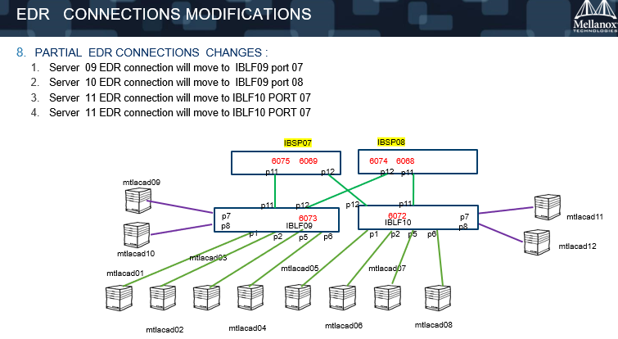

Slide 64
Show sm file on EDR , show the 2 SMs and saqquery to identify name
Show errored ports slide 13
Check routing credit loops show command ibdiagnet –r , show slide 19 & than slide 20
Optional problem wrong deployment or routing engine parameters definitions
Show opensm.conf routing engines section routing engine
Final after correction of the problematic issues run the ibdiagnet again till fixes are achieved
Cron job 2 slides
ibdiagnet
ibdiagnet –pc
Show ibdiagnet sections
Discovery -Show node desc duplication ibdiagnet HDR , fix for switches with Mellanox tool manage the Un managed
Show fabric nodes section
Show fw errors slides 9
Show fabric lids inspection - lids
Show speed link function and the fabric example
Show how to run cable info
Show the cables result info
Show the grep cable result of the element with the degraded result

